Slide 1
Medication administration
For child care providers
Notes:
Training prepared by Becky Millard, M.Ed., Infant and Child Health Coordinator, Vermont Department of Health, Maternal and Child Health Division, April 2017
Detailed review of this training was provided by Breena Holmes, M.D.; Peggy Poppe R.N.; Kary Towne R.N.; Laura Bernard MPH

Slide 2
Welcome
I will be taking attendance and this training will be entered into your BFIS account by Northern Lights. It may take up to 4 weeks to show up in your account.
Participation is required throughout this training. Please keep your video on whenever possible and keep your mic muted unless you are speaking. Questions are encouraged!
You will need the Activity Packet for participation. This was emailed to you with the Zoom link.
You will receive a Document of Professional Development (DPD) form from info@northernlights.ccv.edu within the next couple days. This is only for your records. Please do not send to Northern Lights. Call or email Northern Lights with any questions.
Notes:
5 min
Introduce yourself as the instructor and share a bit about your experience
Take attendance (can use chat for attendance and/or do a quick roll call)
Remind people to change their name on the screen to match the name used for registration [Click on the “Participants” button at the bottom of the Zoom window; then hover your mouse over your name in the “Participants” list on the right side of the Zoom window. Click on “Rename”]

Slide 3
Objectives
Demonstrate procedures for receiving, storing, preparing, administering, and documenting administration of medications
Describe and demonstrate what to do for signs and symptoms of an asthma attack and allergic reaction
Describe symptoms of adverse reactions to medication and actions to take when they are observed
Notes:
1 min
Briefly read objectives aloud

Slide 4
What are your current practices?
We give medication to enrolled children
We work with a health consultant (doctor, nurse, other) to support our health needs
We have a written medication administration policy
We store medications in a secure location
We apply sunscreen to children before they play outside
We have a program checklist that uses the 5 Rights for giving medications
We use a separate medication administration record for each child receiving medication
We have a written policy and procedure to respond to medication errors or incidents
We have a written policy and procedure to handle medication side effects or reactions
Notes:
3 min
Thumb up: We consistently do or this in our program
Thumb sideways: We do this sometimes in our program OR I think we do this
Thumb down: We do not do this in our program OR I don’t know

Slide 5
5 rights of medication administration
the RIGHT CHILD
the RIGHT MEDICATION
the RIGHT DOSE
the RIGHT TIME
the RIGHT ROUTE
Notes:
5 min
Participants will all have the list of the 5 Rights on the back page of their participant packet.
Right Child: 2 identifiers is the standard to ensure it is the right child
Right Medication: read the label at least 3 times
Right Dose: double check and compare order to label; explain that children are small and an overdose can be serious. Briefly discuss OTC medications and how to reach labels. Explain that parent permission form needs to match the label instructions
Right Time: window of 30 minutes
Right Route: oral (by mouth); topical; inhalation; rectal; injectable; (nasal sprays, eye drops, ear drops) Briefly describe the routes and techniques

Slide 6
REFER TO YOUR ACTIVITY PACKET
Receiving and storing medications
Preparing to give medication
Measuring oral medications
Documentation
Notes:
8 min
“Receiving Medications” Checklist
Tell participants that medications must be stored in a secure (licensing) or locked (best practice) location. Discuss how to ensure this is met for medications that need to be refrigerated. Mention that emergency medications need to be readily accessible both inside the program and on field trips. Ask how people handle storage for asthma inhalers and spacers, and for epi pens.
“Preparing to Give Medication” checklist
Mention here that they should only change the form of medication if instructed to do so (crushing, opening capsule); also only serve with food / drink if instructed to do so
Measuring: Talk about not using regular kitchen teaspoons/or demonstrate how different spoons result in different medication amounts (use a plastic spoon and a medicine cup to show the difference)
Documentation: “Medication Administration Log”
Return meds to storage, wash tools, wash hands, observe child for side effects
Record medication, date, time, dose, route and your signature on medication log for Nick
Use blue/black ink; draw line through mistake but never use whiteout (legal document)

Slide 7
Scenario #1
Nick is a 15 month old with an ear infection. He needs a dose at noon of amoxicillin suspension.
Notes:
REFER TO YOUR ACTIVITY PACKET w/ next slide

Slide 8
Medication bottle information
Notes:
8 min
Using page 1 of your activity packet, compare this label with the form that should be completed by the parent. Any discrepancies? (Refrigerate med, shake well)
Use the next page as a review of how you SHOULD be receiving any med. Do you have all the info you need? Understand it? Clear/concise?
How will you measure it- provided by parents.
How will you document it was given (Med LOG handout) LEGAL- blue/black, cross out, Be ACCURATE.
Be sure your program is ready to give the med (Preparing to give Med handout) - paperwork, correct, clean, safe, accurate.

Slide 9
“as needed” medications
Emergency medication – only given “as needed”
Asthma medication like albuterol
Epinephrine auto-injectors like Epi-pens for some allergies
Nasal or rectal seizure medication
Over-the-counter medication
Antihistamines like Benadryl, Claritin, Zyrtec
Fever reducers
Observe children’s behavior carefully
Notes:
5 min
Get as much detail as possible from the parent/guardian when receiving the medication
Should state the maximum number of times the dose can be repeated without seeking further medical care
With emergency as needed medications, best practice is to be sure the parent/guardian leaves it at the program but this is not always possible or feasible (insurance, cost, child moves between multiple homes)
How does your program handle this?
What does your policy say?
Suggest encouraging parents to ask the pharmacist to separate school dosages into a separate bottle when possible

Slide 10
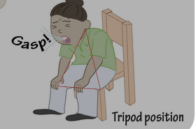
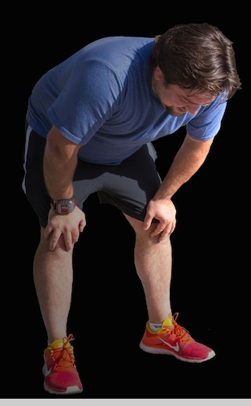
Asthma Signs
Wheezing
Unable to breath
Nasal flaring
Tripoding
Notes:
3 min
What does wheezing sound like…it is high pitch whistling sound when they breath out…because there is something blocking the airways….
think of a stuffy nose, nose is swollen, blocked by mucus and hard to breathe…similar in lungs
Unable to breathe, speak in chopped sentences
Nose opens wide, skin sucks in around the collarbone in the neck
Tripoding…opens airways…you’ll see runners at the end of the race doing this
https://www.youtube.com/watch?v=s1LEchNaIpg&t=44s wheezing

Slide 11
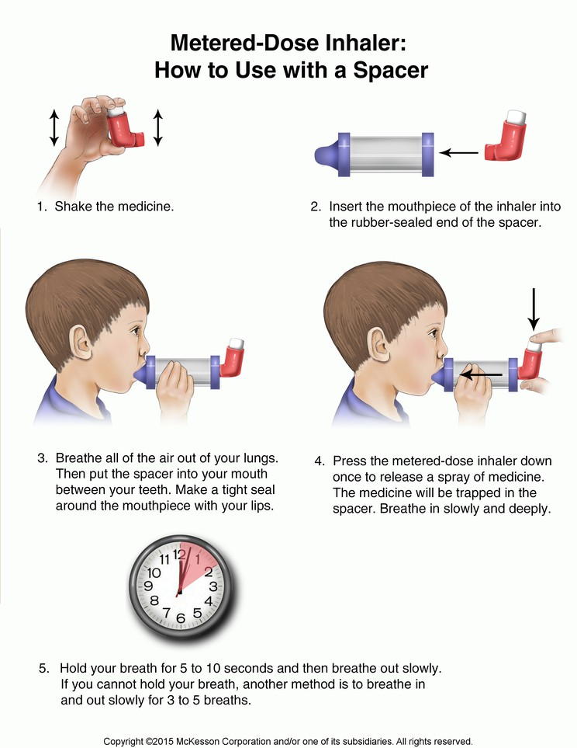
Administering asthma medication
Notes:
5 min
This poster is available in the Resources page on the Northern Lights website. The link was emailed to you when you registered for this training.
Options: -play video below (also embedded in next slide)
-OR demonstrate with inhaler / spacer / practice epi pen
Asthma: https://www.youtube.com/watch?v=f-O8etEE6kQ (2 min 16 sec) - embedded in next slide

Slide 12
Asthma video
Asthma How to use an Inhalers with Spacer and Mask Video

Slide 13
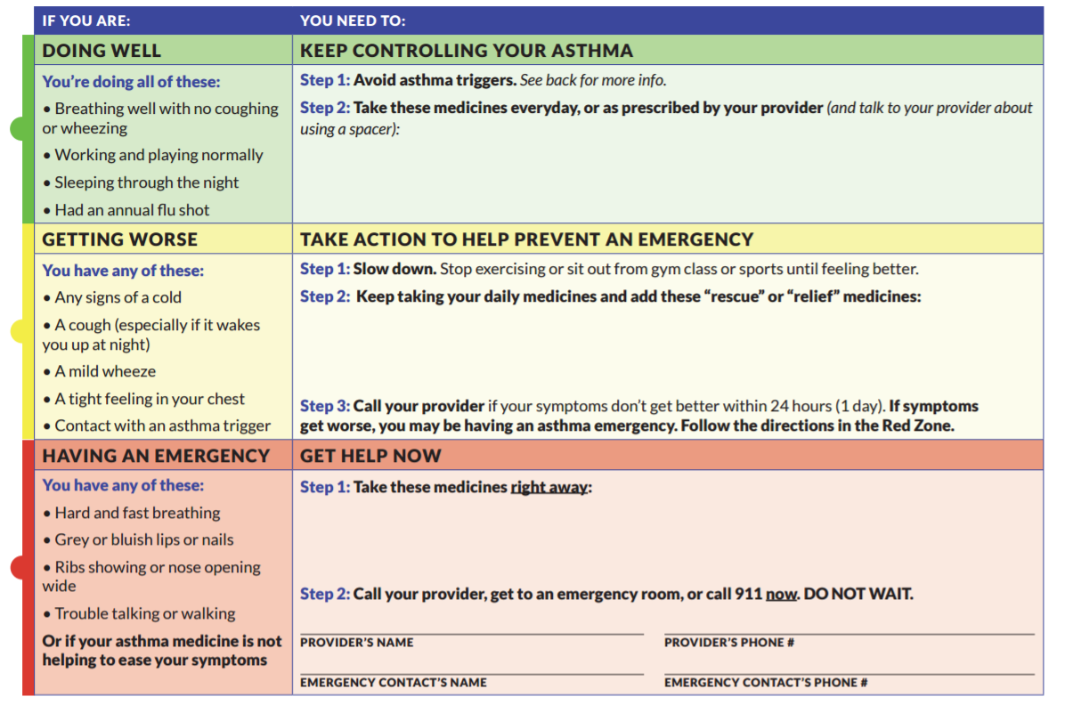
Vermont asthma action plan
Notes:
2 mins
Note the colors on the form to help you assess the situation; this is a downloadable document from the VDH website

Slide 14
Scenario #2
Susie is 4 years old. She was recently diagnosed with asthma which is often triggered by a cold. You notice that she is sitting quietly on the platform of the climbing gym and is not participating with the other children (she is usually very active). She has an intermittent cough, and you think you hear a slight wheeze.
Notes:
8 mins
Participation Packet
Ask participants to review Susie’s asthma action plan independently
Use chat box as a large group to discuss what is happening with Susie and what you think you should do next
Ask if Susie is in Red Zone (thumbs down); Yellow (thumbs sideways); or Green (thumbs up)
Ask for a volunteer to say what they would do next for Susie
**Added scenario** - 30 min after giving the albuterol, she seems to be getting worse – SOB, skin color changing to bluish, wheeze getting worse. What zone now? What would you do?
Use chat box to answer (or ask for volunteer)

Slide 15
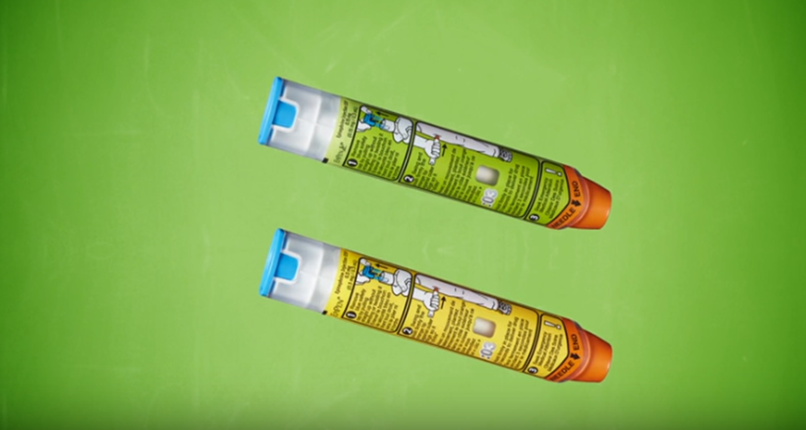
Epinephrine auto injectors
Notes:
Ask if they are comfortable administering an epinephrine auto injector – give a thumbs up (or use polls in Zoom; must be set up ahead of time)
NEWER INFORMATION:
Injection needs to last 3 seconds (used to be 10 seconds); still massage the area for 10 seconds
When giving the medication, touch the spot you want to inject to make sure you don’t inject into a thick seam of material (like jeans) or a cargo pants pocket that might contain a toy (this could cause a wasted dose – critical if you only have one pen)
JR comes with green cover and label…DEMO
Epr is yellow label and cover
Trainers have grey labels

Slide 16
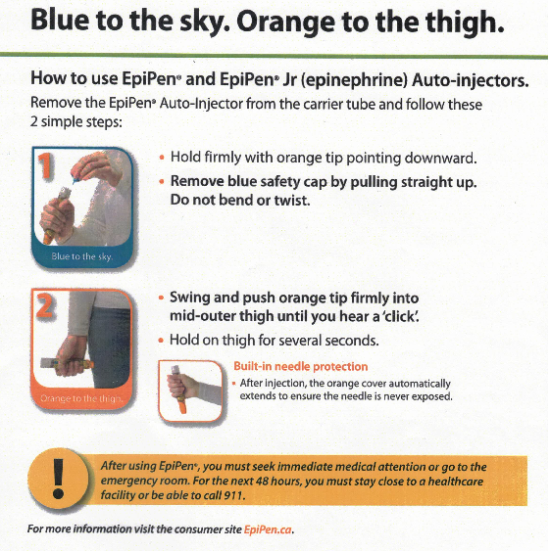
How to use a Epipenn and epipen Jr
Notes:
Option to watch video or demonstrate using an Epi Pen trainer
Epi Pen: https://www.youtube.com/watch?v=EN83hen4D-Y (4 min 24 sec) – embedded in next slide
Injection needs to last 3 seconds (used to be 10 seconds); still massage the area for 10 seconds
When giving the medication, touch the spot you want to inject to make sure you don’t inject into a thick seam of material (like jeans) or a cargo pants pocket that might contain a toy (this could cause a wasted dose – critical if you only have one pen)

Slide 17
EpiPen Video
How to Use an EpiPen Video

Slide 18
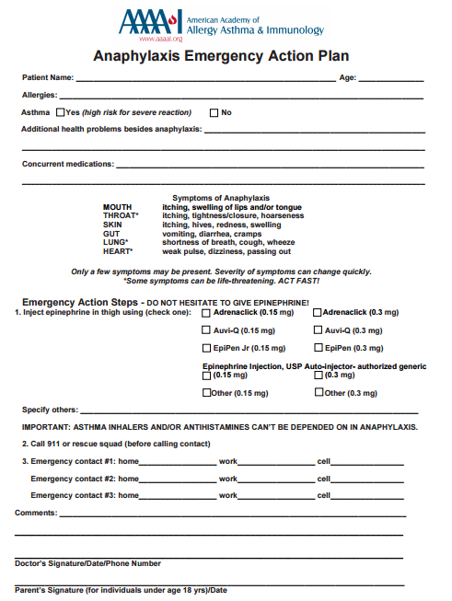
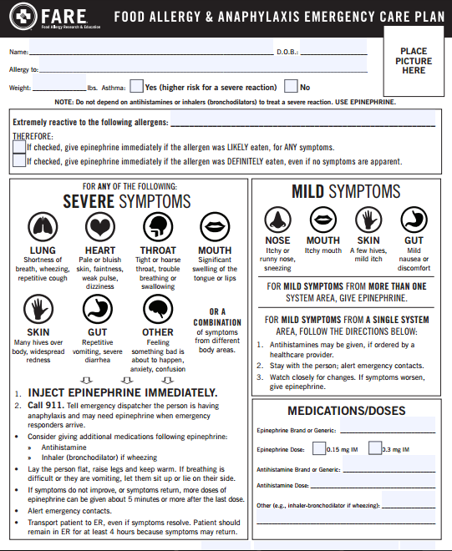
Anaphylaxis emergency care plan
Notes:
There are many different Emergency Action Plans out there that you might see. Be sure to read them through from top to bottom to be sure you understand the plan and your role
Briefly review what should be included in an allergy and anaphylaxis plan. Suggest talking to parents about symptoms they see and what the child looks like when they need treatment. Children’s behavior can give a clue to when they need medication

Slide 19
Scenario #3
José is 2. He is allergic to peanuts. You have a peanut-safe classroom and all parents have signed the peanut-safe classroom agreement. Today is Mary’s birthday. Mary’s grandmother is visiting from out of town and brought in a special snack. After eating the snack José starts pointing to and scratching at his tongue.
Notes:
8 min
Participant Packet
Ask participants to review José’s food allergy and anaphylaxis emergency care plan in their packets
Ask if Jose is in Red Zone (thumbs down); Yellow (thumbs sideways); or Green (thumbs up)
Use the chat to discuss what is happening with José and what you think you should do next
Ask for a volunteer to say what they would do next for Jose

Slide 20
WORDS A CHILD MIGHT USE TO DESCRIBE A REACTION
• “This food is too spicy.”
• “My tongue is hot [or burning].”
• “It feels like something’s poking my tongue.”
• “My tongue [or mouth] is tingling [or burning].”
• “My tongue [or mouth] itches.”
• “It [my tongue] feels like there is hair on it.”
• “My mouth feels funny.”
• “There’s a frog in my throat.”
• “There’s something stuck in my throat.”
• “My tongue feels full [or heavy].”
• “My lips feel tight.”
• “It feels like there are bugs in there.” (to describe itchy ears)
• “It [my throat] feels thick.”
• “It feels like a bump is on the back of my tongue [throat].”
If you suspect that a child is having an allergic reaction,
follow their emergency care plan and treat the reaction quickly.
Notes:
2 min
Words that young children may use to describe a reaction
LAST LINE: *** If you suspect that a child is having an allergic reaction,
follow their emergency care plan and treat the reaction quickly.

Slide 21
Emergency seizure medication
Prescription medicine used for the short-term treatment of seizure clusters
Federally controlled substance because it can be abused or lead to dependence
Comes in various doses: 5 mg, 7.5 mg, 10 mg, 15 mg, or 20 mg
The most common adverse reactions are sleepiness and headache
Notes:
3 mins

Slide 22
Diastat (rectal)
Do not give DIASTAT ACUDIAL until:
1. You have confirmed:
Prescribed dose is visible and if known, is correct
Green “ready” band is visible
Confirm the dose and green ready band are visible.
2. You have thoroughly read these instructions
3. Reviewed administration steps with the doctor
4. Understand the directions
Before administering DIASTAT ACUDIAL for the first time, your caregiver must read and completely understand the dosing instructions.

Slide 23
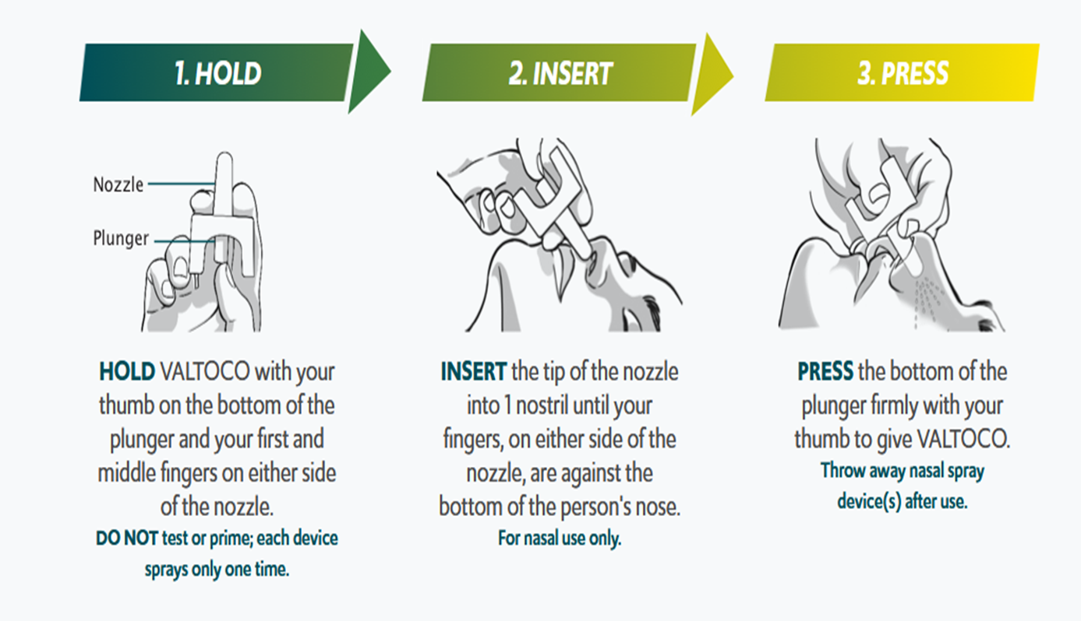
VALTOCO (nasal for ages 6+)
Notes:
5 min
If the medicine is given during or after a seizure with loss of consciousness, turn the person on their side so they are facing you (or the person who will be giving it). If the person has had a focal seizure or the medicine is given after or between seizures, the person can be sitting in a comfortable position.
After administration:
Call 911 if part of the plan
Stay with child and watch closely for breathing issues
Document time of admin, which nostril, effectiveness
Safely discard unit

Slide 24
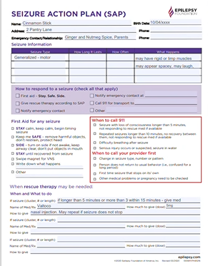
Seizure action plan form
Notes:
1 min

Slide 25
medication errors and Side effects
Common Errors in Medication Administration:
Most often occur with OTC medications
Could be errors with any of the 5 rights (wrong child, wrong medication, wrong dose, wrong time, wrong route)
How can you prevent these errors?
Medication Side Effect:
A secondary and usually adverse effect of taking a medication
Common side effects include: upset stomach, diarrhea, loose stool, dry mouth, drowsiness, change in activity or mood, dizziness, flushing/sweating, rashes, rapid heartbeat, nausea
While not all side effects are problematic, be sure to watch for adverse effects
Notes:
8 min (including next slide)
Best way to prevent medication errors is to review the 5 Rights
One common error is forgetting to give a dose of medication; set an alarm to remind you
Each time an error is made, review what went wrong and address what has to happen so it doesn’t happen again; also consider if you should make any changes to your medication administration policy or procedures to help ensure it doesn’t happen again

Slide 26
Errors and Side effects (continued)
Effects of medication vary from child to child – best solution is to carefully watch child after administering medication
Review consent form and medication label to see if there are potential medication side effects
Best source of information is the health care provider
Pharmacists are also a great source of information
With medication errors or side effects, act quickly
**If the child is in distress, call 9-1-1**

Slide 27
Who do you call?
Call 9-1-1
Call poison control
Call parent/guardian
No call needed
Take out your phones – add a new contact Poison Control # 1-800-222-1222
Notes:
10 min
OPTIONS: read scenarios and call on individuals to answer (let them know it’s okay to give their best guess if they are not sure); or read the scenarios and ask everyone to type their answer in the chat box
At some point (if it comes up) you can remind them that AAP no longer recommends giving syrup of ipecac
Finish this slide by asking everyone to take out their mobile phones and enter the number for poison control into their phones. 1-800-222-1222

Slide 28
Other medication incidents
Child refusal, spit out doses, vomited doses, spilled medication
Always:
Notify director and notify parent/guardian
Fill out a medication incident report (also note error on Medication Log)
Develop and document a follow up plan
Never:
Repeat a dose without specific instructions from health care professional
Notes:
2 minutes
Participant Packet: “Medication Incident Report” (CFOC) or “Sample Child Incident Report” (CDD) – they can use either report (CFOC includes much better detail in an event where follow up is needed)
Will complete the report with the next slide

Slide 29
Scenario #4
You gave Nick his dose of amoxicillin at noon and recorded it. At 12:30, you note that Nick is scratching his arms and is developing a rash on his arms. He is happy and playful and is not having any breathing difficulties. What do you do?
Notes:
10 min
Participant Packet – Medication Incident Report
OPTIONS: use breakout rooms w/3-4 people in each group, have them discuss situation and what they would do. Ask the group to complete the medication incident report based on how they handled the situation (be creative). Ask for a volunteer to share what their group worked on (allow 10 mins for group activity);
OR have individuals complete the Incident Report independently and then use the chat box to share what they wrote.
Example might be to: notify the parent who calls the child’s health care professional. Parent picked up at 1pm and child was brought to health care professional’s office where he received Benadryl. His amoxicillin was discontinued and he was given a new antibiotic.

Slide 30
Field trips and medication outdoors
Someone authorized to administer medication must be present
Medication must be secure and labeled
Maintain proper temperature and conditions for medication
Carry copies of emergency contact information and the child’s medical forms
Use good hand hygiene
Notes:
5 minutes
Consider a waist pack for securing medication that does not need refrigeration
If refrigeration is required, take a cooler and lock box with you
Alcohol based hand sanitizer can be used when no sink is available

Slide 31
What Would you do? 1
A parent asks you to give the morning dose of a medication that is ordered three times a day
A parent asks you to give a medication, but the medication is incorrectly labeled
A child has had three seizures and has been prescribed emergency medication. The parent brings in a correctly completed consent form and correctly labeled medication. No staff member has had training in this specific procedure required.
Notes:
8 min (including next slide)
Options: Use thumbs up, sideways, or down (you can stop screen sharing and go to gallery view to see all participants); OR use the chat box to write “Yes”, “Not sure” , or “No” (be sure to look for any “not sures” to address questions)
Thumbs up = yes, fine to do this
Thumbs sideways = not sure OR maybe OR to indicate you have a question
Thumbs down = no, don’t do this

Slide 32
What Would you do? 2
A parent asks you to provide their child with cough medicine. The manufacturer’s label including dosage for child’s age is clear.
Parent brings in a homeopathic remedy and asks you to administer to their child. The medication is in a plastic baggie with a handwritten instruction label attached.
A parent drops off medication and tells you the only way the child will take the medication is if you mix it with milk/formula. There is no written indication from the doctor or pharmacist that states the medication should be mixed with milk/formula.
Notes:
Question 5 might raise questions about the language in the regs that allows for herbal/folk remedies to be given to children (in the CBCCP regs 5.6.3 page 44) but you can remind them that the regs clearly state that all prescription and non-prescription medication must be in its original container (CBCCP regs 5.6.6 and 5.6.7 page 45) so they should not administer this medication since it was provided in a baggie.
You can also talk with them about their rights to create specific policies that are of “higher” standard than the regs (which are baseline) – so they’re allowed to decide not to administer homeopathic remedies at all if they choose (should be included in their medication policy).

Slide 33
creating med admin policies
Creating and implementing effective medication administration policies and procedures helps protect both the children and the program
One key to any effective policy is that all staff know about, understand, and can effectively follow it
Review the attached packet for information about creating effective medication administration policies
Notes:
3 min
Please share with the participants about your favorite resources for building medication administration policies!

Slide 34
SLOW DOWN!
Review the 5 rights! Read the medication instructions carefully and make sure you understand them.
Discuss the medication administration plan thoroughly with parents and make sure you are on the same page.

Slide 35

Questions?
Thank you!
Notes:
5 min
Let participants know that a training evaluation will be emailed to them tomorrow, and that they should receive their DPDs within a few days. If anyone has questions about getting credit for attending, tell them to reach out to Northern Lights for help.
You are welcome but not required to share your email address for follow up questions. Feel free to use your VSC email, if you check it.

